Slide 1
Black Friday Analysis
Prepared by : Mustafa Ashraf

Slide 2
The dataset contains customer transaction data during Black Friday.
Analysis Target :
Identify top customer segments by spending - Analyze purchase behavior across age, gender, and marital status - Determine top-performing product categories - Analyze city-based purchasing patterns

Slide 3
Dataset Description:
1. Number of Transactions : 550 k .
2. Columns : Age , Gender , Purchase , City , Occupation.
3. Type of Data : Sales Transactions .

Slide 4
Data Cleaning :
Removed missing values .
Converted data types .
Renamed columns .
Created calculated metrics .

Slide 5

This project analyzes customer purchasing behavior during black Friday to identify key drivers of sales and revenue .
Total Sales: 5bn .
Avg Purchase: 9K .
Transactions: 550K.

Slide 6
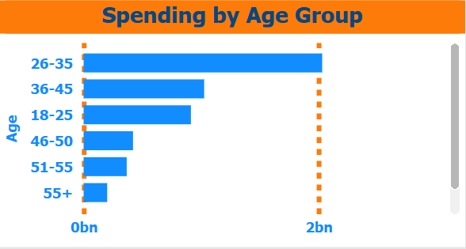
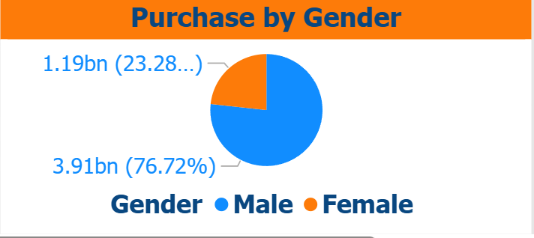
Customer Analysis
The age group 26–35 generates the highest spending among all age groups.
Male customers contribute the majority of total sales, accounting for approximately 77% of overall purchases.

Slide 7
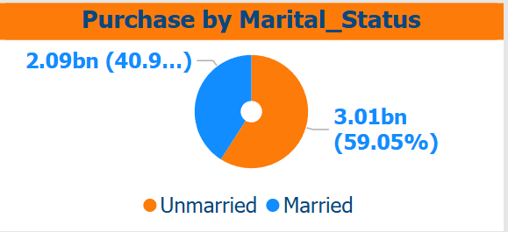
Customer Analysis
Unmarried customers generate more total sales than married customers.

Slide 8
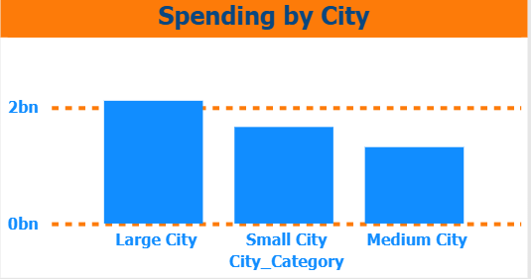
City Analysis
Large cities contribute the highest total sales compared to medium and small cities
• Large cities generate the highest revenue
• Urban areas drive sales growth

Slide 9
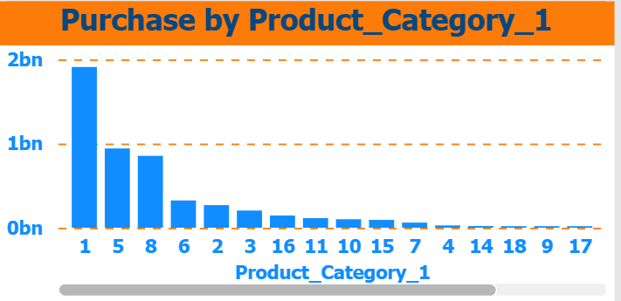
Product Analysis
Product Category 1 dominates sales, significantly outperforming other categories
Category 1 dominates total sales
High demand concentrated in few categories

Slide 10
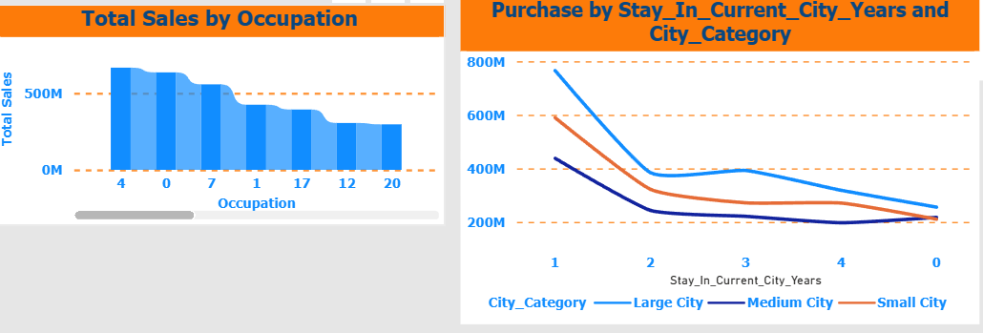
Impact of Occupation and City Stay Duration on Sale
Certain occupation groups (such as occupation 4 and 0) show significantly higher total spending than others.
Customers who recently moved to a city (1–2 years) tend to have higher purchase activity, especially in large cities

Slide 11
Conclusion
Key business recommendations :
• Targeting high-value age groups, focus marketing effort on this aged
customers
• Expanding in large cities
• Promoting top-selling products

Slide 12
Thank you
Prepared by Mustafa Asharf

